Slide 1
Technical English for Computer Science
Week 12
Dr. Nur Banu OĞUR

Slide 2
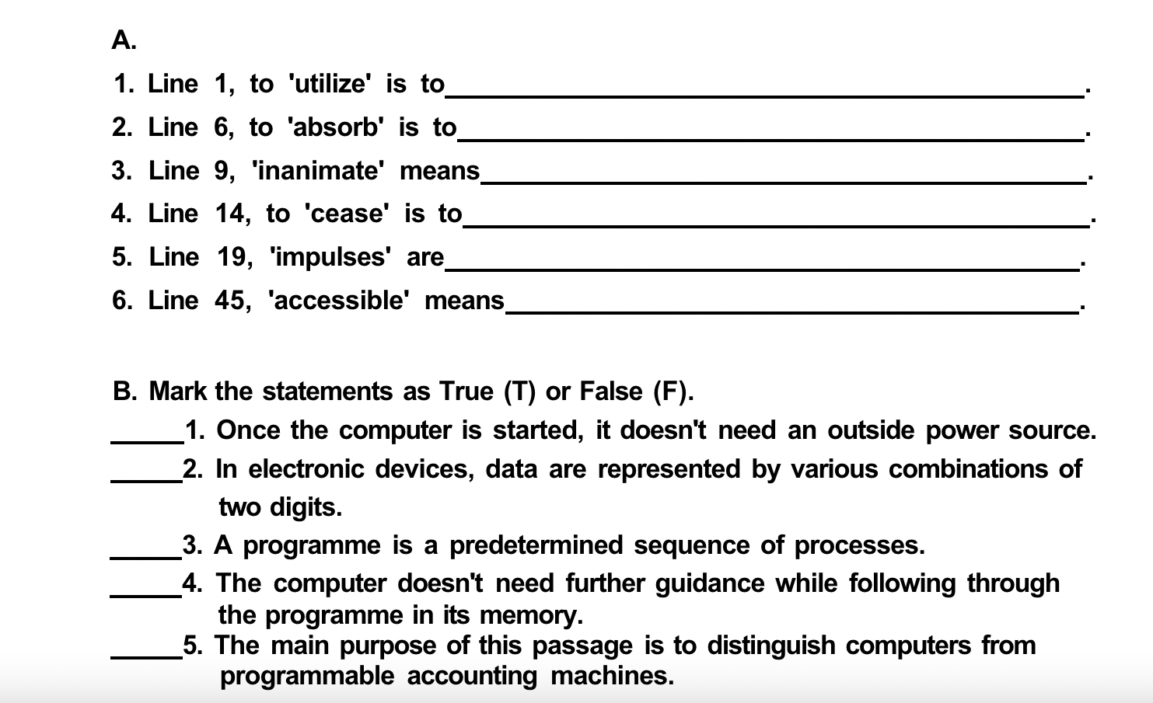
The Computer

Slide 3
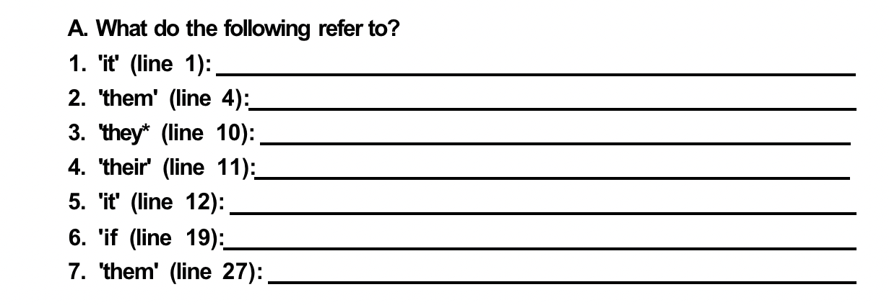
Computers In The Modern World

Slide 4
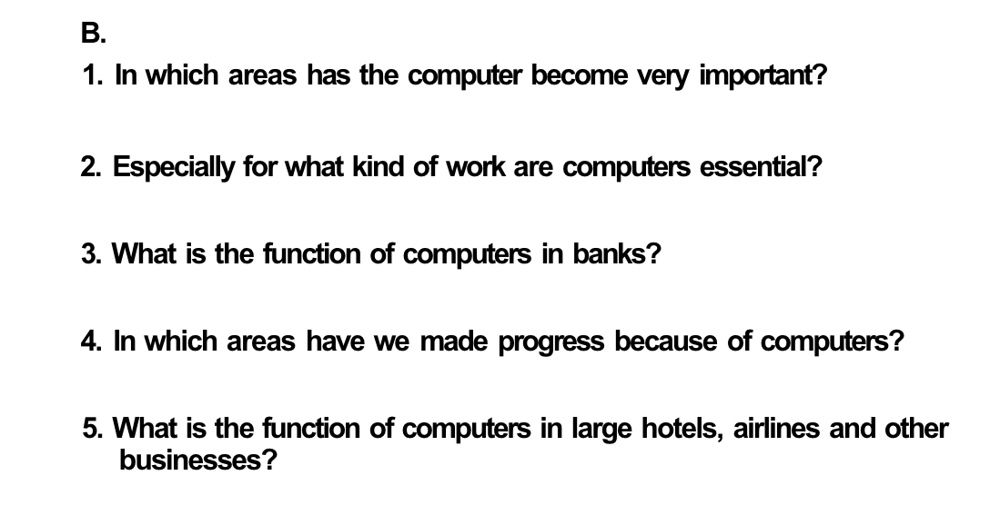
Computers In The Modern World

Slide 5
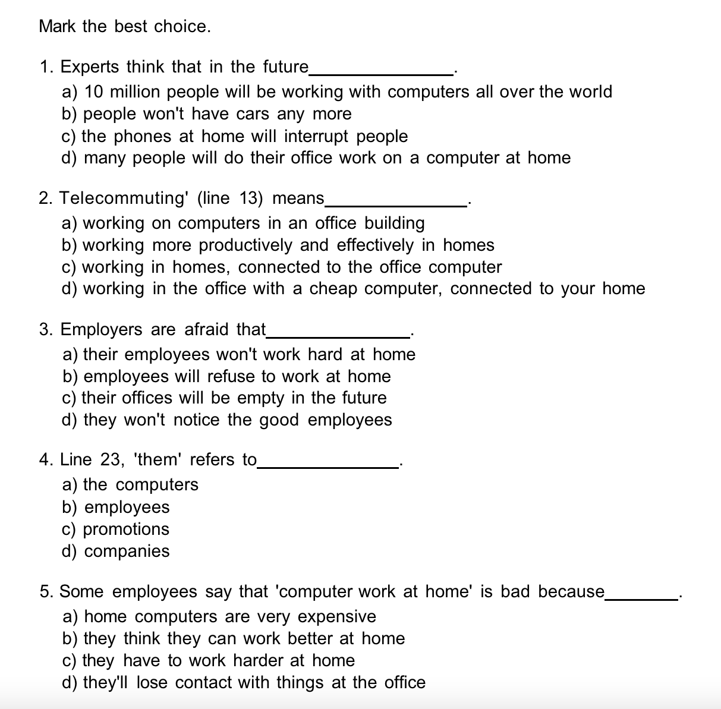
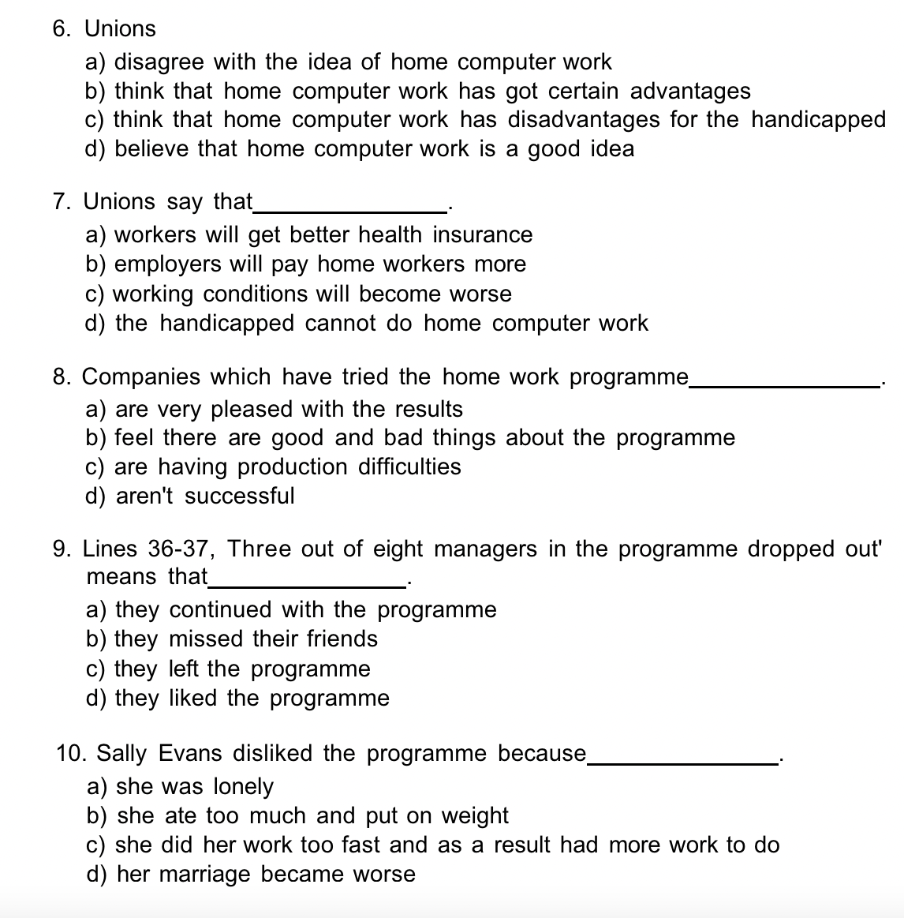

Slide 6
Writing…
Do you think the use of virtual reality in computer war games is going to affect young people’s attitude to violance?

